Slide 1
Search-Based Model Optimization using
Model Transformations
Joachim Denil (U of Antwerp, McGill)
Maris Jukss (McGill University)
Clark Verbrugge (McGill University)
Hans Vangheluwe (U of Antwerp, McGill)
SAM 2014, Valencia

Slide 2
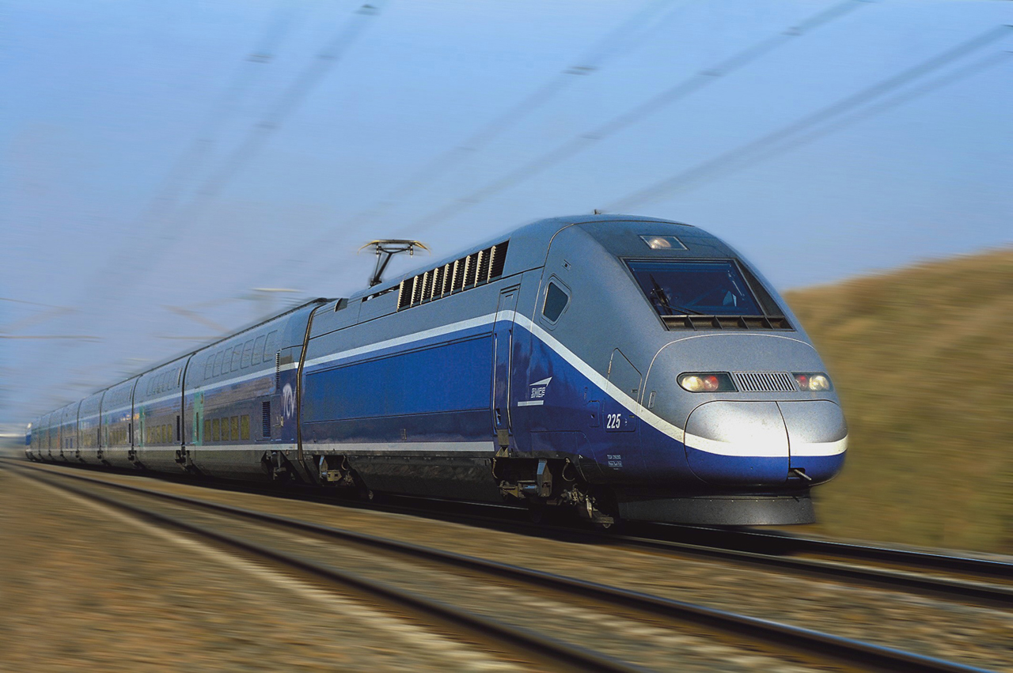


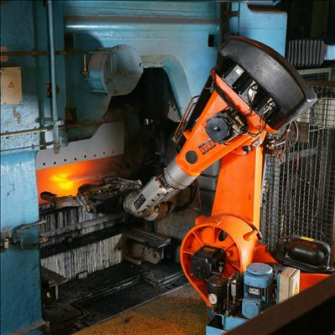
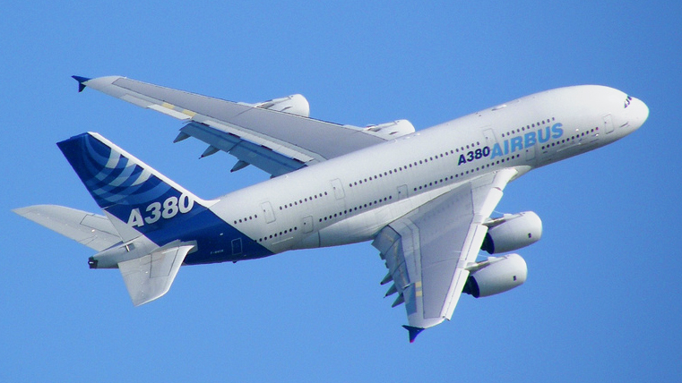
Introduction
Complex Engineered
Systems
Notes:
Design: compare different alternatives with respect to properties
Different problems in engineering: automotive, mechanical (gears and clutches)
Different techniques like constraint satisfaction, LP, heuristics and meta-heuristic search techniques, etc.
Yesterday paper at CMSEBA
We -> Rule based exploration with search techniques

Slide 3
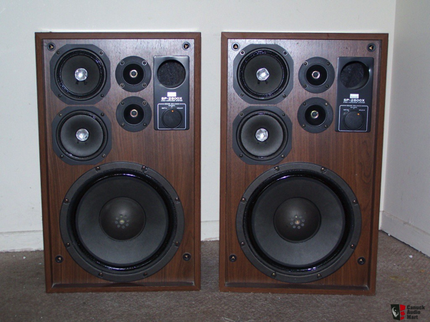
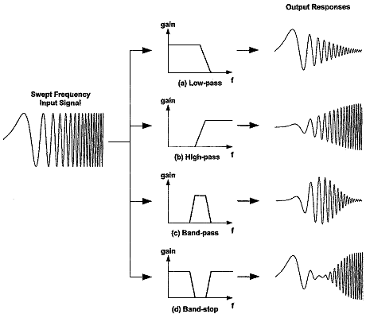
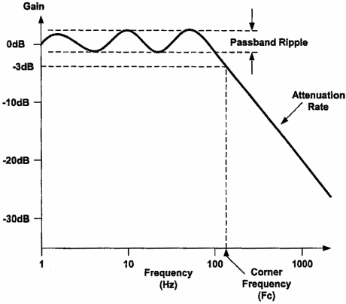
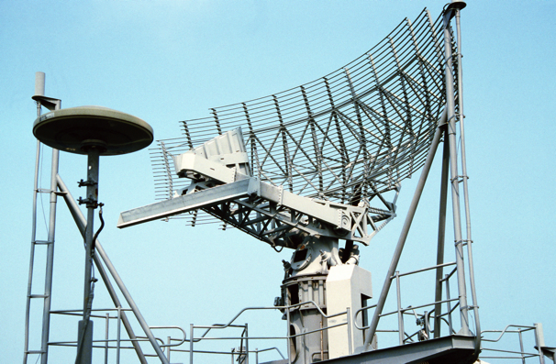

Running Example

Slide 4

Running Example

Slide 5

Running Example
Feasible? Good?
L. Nagel and D. Pederson. Spice (simulation program with integrated circuit emphasis). Technical Report UCB/ERL M382, EECS Department, University of California, Berkeley, Apr 1973.
Notes:
4 components needed:
Representation for search
Method to evaluate candidate solution
Methods to create candidate solutions
And search technique

Slide 6
Rule-Based Model Transformation
Rule-Based Model Transformation:
  LHS, RHS, NAC
Operations on Filters:
  Create a Serial connection
  Create Parallel connection
  Create Shunt connection
  Create Random connection
  Change component
Opposite operations!

Slide 7

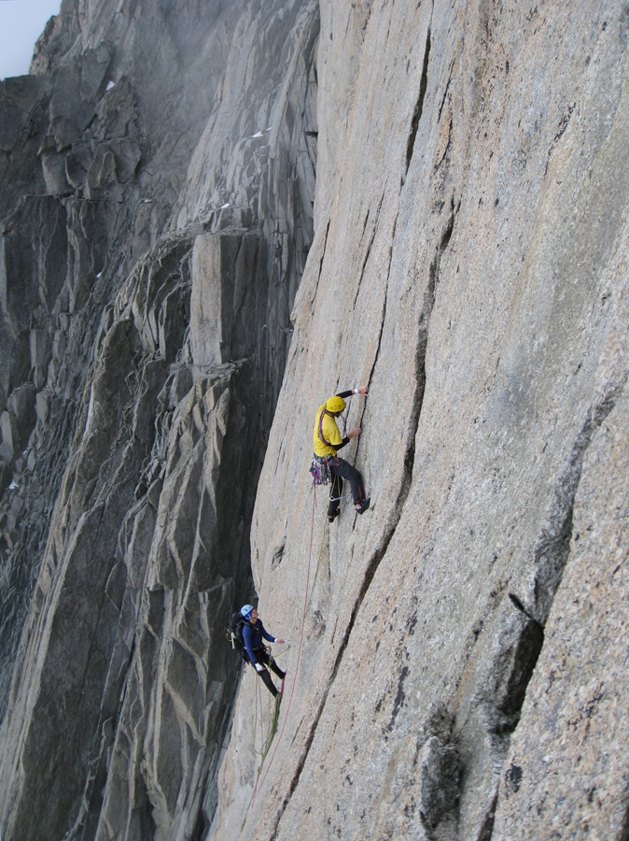
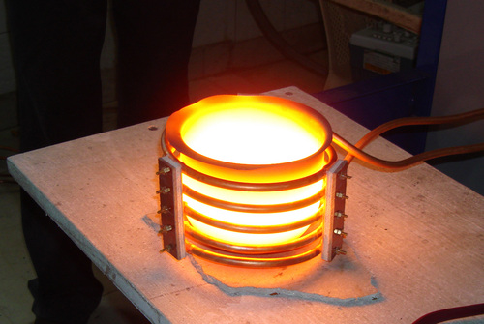
SBO

Slide 8
Results: Hill Climbing

Slide 9
Results: Simulated Annealing

Slide 10
HC and SA Results

Slide 11
Represent Domain Knowledge!

Slide 12
Optimization Chains!
Lúcio, L., Mustafiz, S., Denil, J., Vangheluwe, H., & Jukss, M. (2013). FTG+ PM: An integrated framework for investigating model transformation chains. In SDL 2013: Model-Driven Dependability Engineering (pp. 182-202). Springer Berlin Heidelberg.

Slide 13
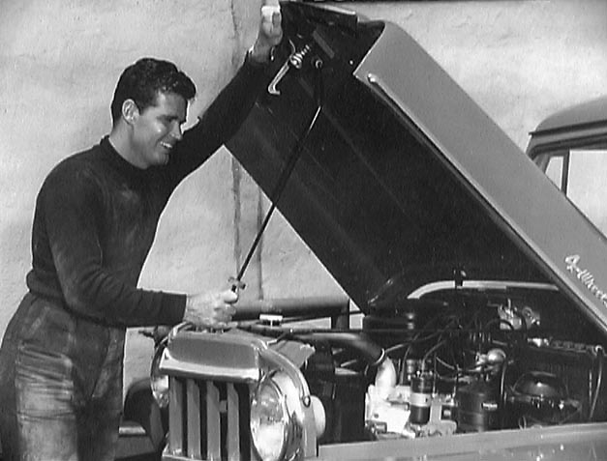

Slide 14
Rule-Based Model Transformations
Syriani, E., Vangheluwe, H., & LaShomb, B. (2013). T-Core: a framework for custom-built model transformation engines. Software & Systems Modeling, 1-29.

Slide 15
Exhaustive and Random Search

Slide 16
Hill Climbing and Simulated Annealing

Slide 17


The Good, The Bad
No other representation needed
Intuitive (Syntax close to domain!)
Easy to embed in MDE
Domain Knowledge
Optimization chains
Can be extended (for example: Branch and Bound from exhaustive)
Matching is computationally intensive
Not the most optimized solution (as with all meta-heuristics)

Slide 18
Conclusions
SBO using Model Transformation
  Model is representation
  Rules guide the search
  Rules in language of domain expert
  Schedule implements search algorithm
Domain knowledge in rules
Optimization chains

